Slide 1
College Basketball Analysis
By: Jake Conard
Course: IST652
Date: 7June2023

Slide 2
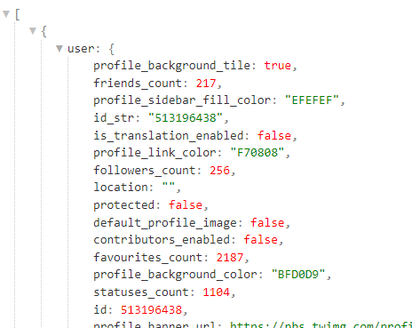
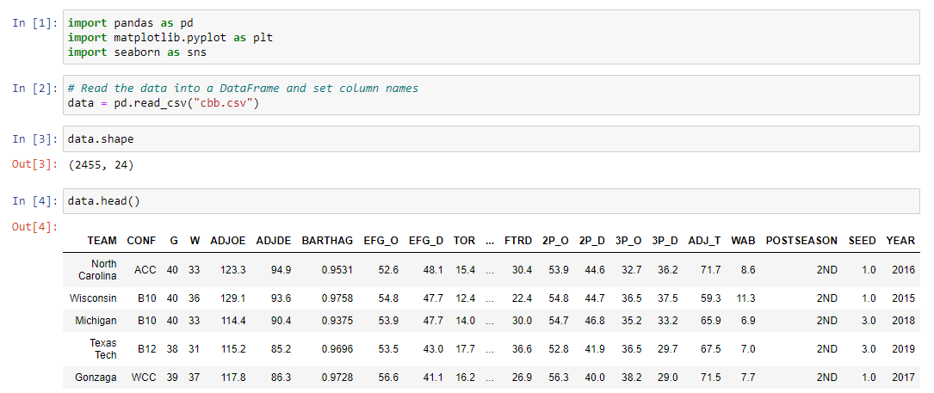
Datasets
Dataset 1:
Division 1 College Basketball seasons from 2013 – 2019. The dataset has 2,455 rows and 24 columns. The dataset is in a csv that can be downloaded from Kaggle.
Dataset 2:
College Basketball Twitter Dataset. The data includes College Basketball Tweets from March 27th 2017.

Slide 3
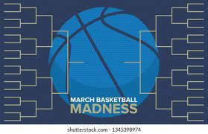
Key Questions to Answer
What Stat had the highest correlation with championship caliber teams? (dataset 1)
What teams won the most Championships from 2013 - 2019? (dataset 1)
What were the most common ‘words’/’tokens’ that were tweeted? (dataset 2)
What was the time that most tweets were sent? (dataset 2)
What username has the most friends and which username has the most followers? (dataset 2)

Slide 4
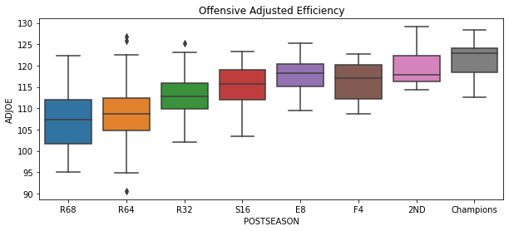
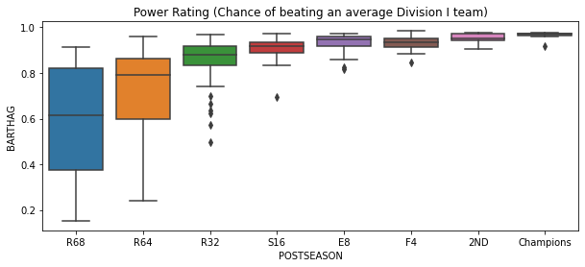
What Stat had the highest correlation with championship caliber teams?

Slide 5
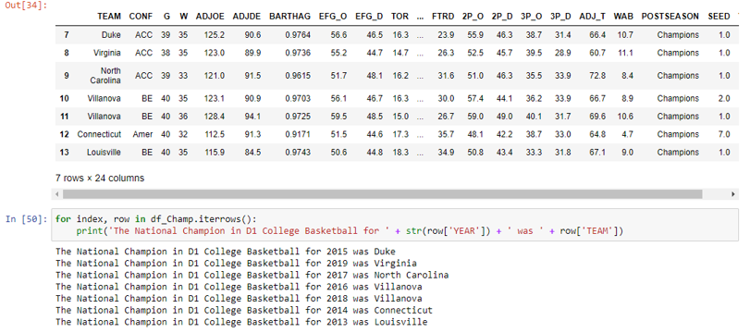

What teams won the most Championships from 2013 - 2019?

Slide 6
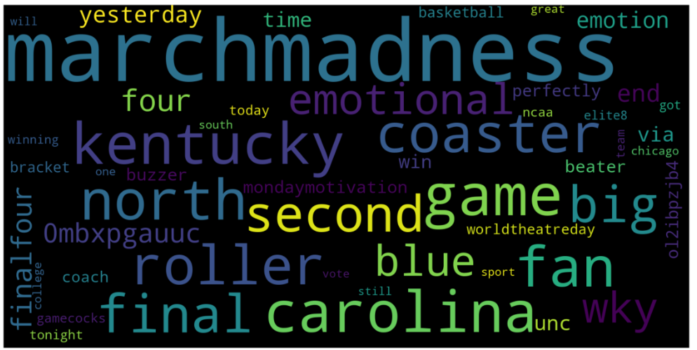
What were the most common ‘words’/’tokens’ that were tweeted?
As expected, the most common token tweeted in this dataset was the token ‘marchmadness’, but some of the other most common tokens were Kentucky and Carolina which were too teams that were a part of the tournament in 2017.

Slide 7
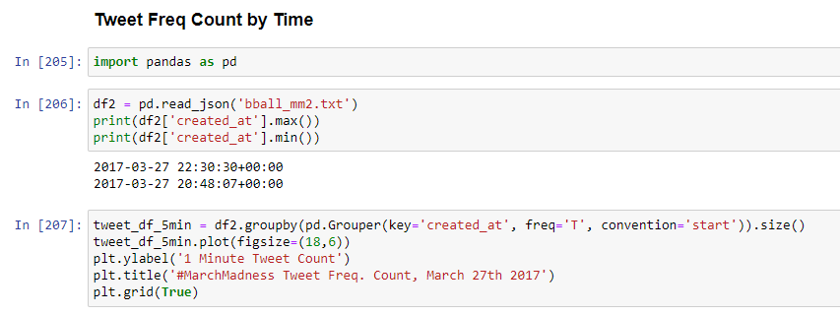
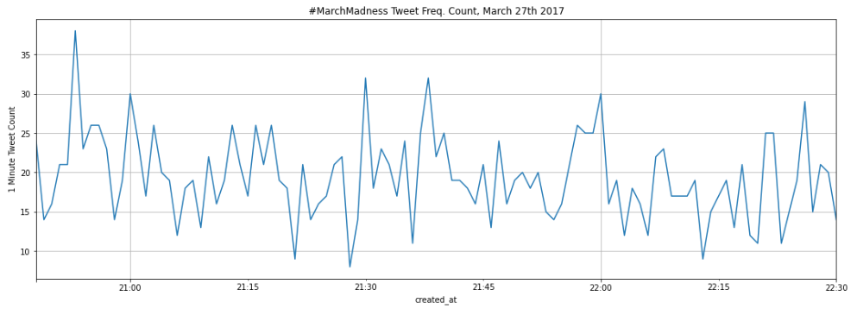
What was the time that most tweets were sent?
All of the tweets were sent on the 27th of March of 2017 with the most tweets sent around 8:45 PM.

Slide 8
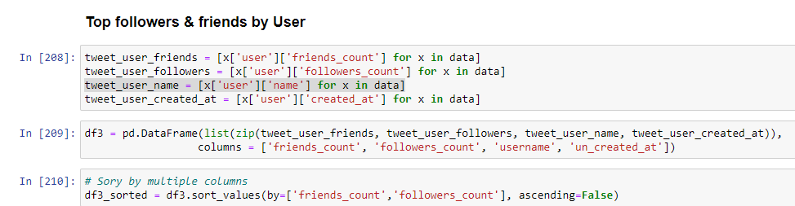

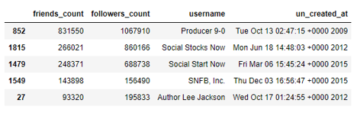
What username has the most friends and which username has the most followers?
The username with the most followers and the most friends was “Producer 9-0” with 831k friends and 1 million followers.

Slide 9
Conclusion
The biggest take away from analyzing the Division 1 College Basketball Kaggle and Twitter datasets is:
Adjusted Offensive efficiency is the most important stat in determining which teams have the best likelihood of winning the March Madness tournament.
The team that has won the most National Championships from 2013 – 2019 is Villanova with two.
The most common token tweeted regarding College Basketball from this dataset is ‘marchmadness’.
The most active time for tweets during the twitter dataset was around 8:45 PM on 27 March 2017.
The username with the most friends and followers was ‘Producer 9-0’ with 831k Friends and over a million followers.

